Slide 1

Environment Boundary
stimulate (internal)
Feature Model
stimulate (internal)
stimulate (external)
stimulate (external)
perform
Mashup
perform
Person X
Person Y
Modeling Activities
Modeling Activities
directly affect
directly affect
indirectly affect
indirectly affect
Personal View X
Personal View Y
export to external

Slide 2
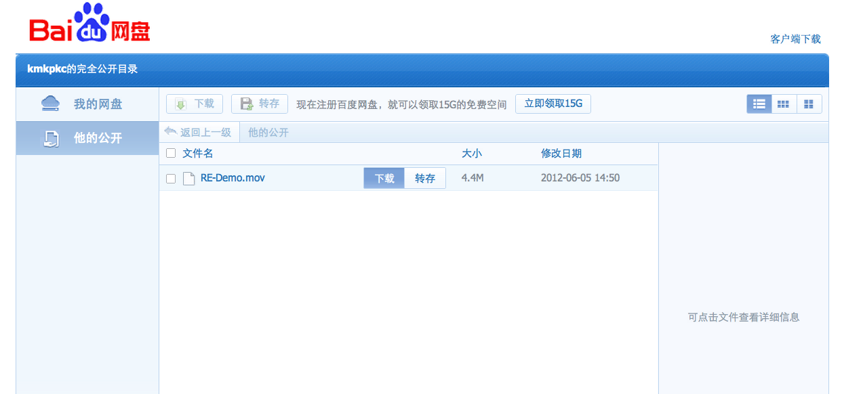
1. The file is here.
2. Move your cursor near the file, and two buttons will appear. Click the left one.

Slide 3
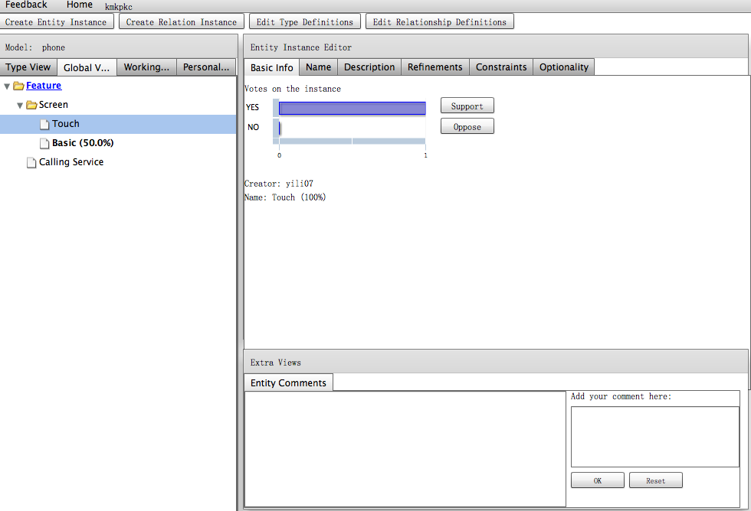
Toolbar
Feature Editor
The Shared Feature Model
and Personal View
Other Functions

Slide 4
Collaborator Name Indicator:
Show your collaborator’s editing location.
“Hot” features are shown in large size.
Features created by this user are underlined.
Controversial features are bolded.

